Slide 1

Equitable Briefing
Women Lawyers Association (NSW), Newcastle 5 October 2022
Kate Eastman AM SC

Slide 2
Topics
Why talk about equitable briefing?
What is equitable briefing?
Law Council of Australia’s equitable briefing policy – 4 years on
Practical aspects of equitable briefing

Slide 3
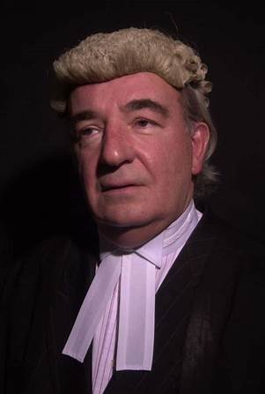
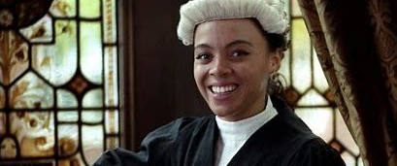
How do we see barristers?

Slide 4
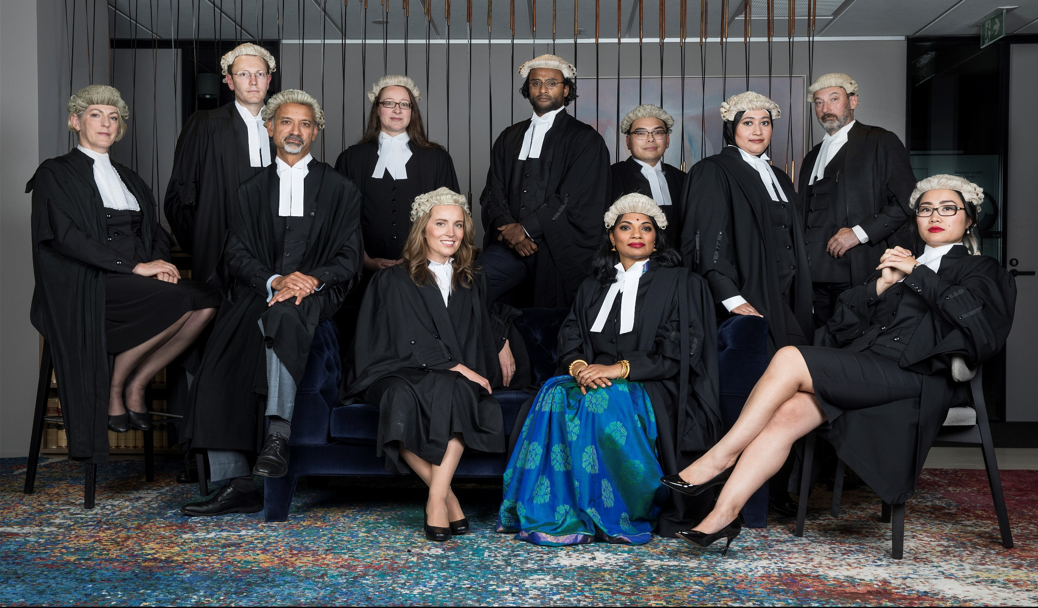

Slide 5
Profile of Australian barristers 2021
Membership statistics, January 2021 (Australian Bar Association)
State or Territory | Practising Counsel | Female | Male | Unspecified
ACT | 63 | 13 (20%) | 50
NSW | 2391 | 571 (23.9%) | 1820
NT | 28 | 9 (32%) | 19
QLD | 1146 | 280 (24.4%) | 866
SA | 240 | 64 (26.7%) | 176
TAS | 40 | 7 (17.5%) | 31 | 2
VIC | 2211 | 690 (31.2%) | 1521
WA | 260 | 67 (25.7%) | 193
Total | 6379 | 1701 (26.7%) | 4676 | 2

Slide 6
Snapshot of the NSW Bar
Statistics | New South Wales Bar Association (nswbar.asn.au) at 30 September 2022
Total barristers 2427
Women 24.8%
Barristers over the age of 60
Women 4%
Men 28.4%
(46% of the Bar = men over 50 years)
Barristers under the age of 40
Women 7.25%
Men 13.2%
Senior Counsel
Women 2% (52)
Men 13.5% (328)

Slide 7
National Attrition and
Re-engagement Study
(NARS) 2014
Law Council of Australia – survey
  quantitative data and confirm trends in progression and attrition rates of female lawyers
  examined the qualitative reasons behind these trends
Discrimination & sexual harassment
  50% of all women reported experience of sex discrimination/ 25% of all women experienced sexual harassment
  Female barristers were also more likely than other females to report experiencing sex or family/carer responsibilities discrimination, bullying and intimidation.
Unconscious bias as barrier to career progress
Lack of mentors
Work-life-family balance - inflexible working arrangements
Unequal access to work
Unequal pay

Slide 8
NSW Bar pay gap in 2014
 | Women | Men
Average fees | $269,958 | $437,450
Gender pay gap | 38% (national average was 18.2% in 2014)
Gross fees under $200,000 | 41% | 24%
Pay difference under 5 years |  | $29,377

Slide 9
So what was going on?
Appearances in superior courts
women appeared below the proportion of women at the Bar – Visible Targets
Source of the briefs
  public v private sector
  firms v in-house
Type of work
  women’s work – family, crime, legal aid, public, pro-bono
  commercial work
Value of the work
  fixed v market rate of fees

Slide 10
Equitable Briefing initiatives pre 2016
2003
New South Wales Bar Council adopts NSW Equitable Briefing Policy
SCAG asked the LCA to develop a national model equitable briefing policy
2004
LCA’s Model Equal Opportunity Briefing Policy for Female Barristers and Advocates
2009
LCA’s Equitable Briefing Policy for Female Barristers and Advocates (revised)
NSW Premier’s Direction on Briefing Senior Counsel for NSW Govt
2015
NSW Bar Association Equitable Briefing Working Group Report (August)
LCA Forum on Equitable Briefing
LCA - 2009 Court Appearance Survey

Slide 11
Law Council of Australia
2016 Policy
Three core elements: Targets, Value and Reporting
By 1 July 2018 for the briefing of:
Senior female barristers (10 or more years): 20% of all briefs and/or all brief fees paid to senior barristers
  Junior female barristers (less than 10 years): 30% of all briefs and/or all brief fees paid to junior barristers
By 2020 women are briefed in at least 30% of all briefs & 30% of the value of all brief fees
Recommendation targets
Confidential reporting against the targets by 30 September each year.
Equitable Briefing Policy - Law Council of Australia

Slide 12

Why targets?
“It is a matter of time” has not resulted in gender equity and we are going backwards
Gulf between women law graduates and women practising as barristers
Targets are simple a way of measuring progress
If there is reporting and measures = gets measured is more likely to get done
Lawyers work well with targets – be it budgets, KPIs, tenders, case loads
A target is ONE strategy and not the only strategy

Slide 13
Implementation of the LCA Policy
470 adoptees
  137 “briefing entities”
  333 barristers
30 September 2020 reporting deadline, an overall reporting rate of 38%
Overall, Briefing Entities reported briefing barristers 22,347 times:
  6,350 to female barristers
  15,997 to male barristers
  approximately 28% female to 72% male

Slide 14
Results for 2019 - 2020
Junior women barristers (under 10 yrs)
Senior women barristers (10 yrs +)
Briefing Entities briefed junior barristers 10,648 times in FY 2019-2020.
Women junior barristers - 3,941 (37%) of briefs.
Improvement from the start of the Policy:
  11 % increase for women juniors receiving led briefs
  8 % for women juniors receiving unled briefs
Briefing Entities briefed senior barristers 11,699 times in FY2019-2020
Women senior barristers - 2,409 (21%) of briefs.
Improvement of the start of the Policy:
  3% from the previous year
  9% since the beginning of the Policy.

Slide 15
Value of briefs

Slide 16
Over the 4 years of reporting

Slide 17
NSW Government Equitable Briefing
2019-2020 FY
NSW Government Agencies briefed counsel on 2,916 occasions
NSW exceeded
the LCA targets
Women counsel briefed in
994 (34%) of all
NSW government briefs
Women Senior Counsel
33% of briefs
43% ($3.9m)
of the value of all brief fees
Women Junior counsel
34% of briefs
35% ($8.1m)
of the value of all brief fees
NSW Equitable Briefing Report
https://www.justice.nsw.gov.au/legal-services-coordination/Pages/info-for-govt-agencies/eq-briefing-policy.aspx

Slide 18
Into the future – what next for equitable briefing?
Targets
Reporting
Expanding to other areas of diversity

Slide 19
Myths that influence briefing
Recognise and acknowledge biases, particularly unconscious
  “if the women were better, they would get the work”
  “it is demeaning to women barristers to have the policy”
  Do you require every male barrister to be exceptional, with a PhD from Oxford?
  Do you unconsciously think women are only suited to certain work?
Do you make excuses?
  we would brief a woman but we just don’t know any with sufficient experience or in the area”
  “are you sure they are good enough?”
  “can they cross-examine, hard enough?”
  “but Joe Smith has a young family”
  “not sure if Judge Cranky will listen to her”

Slide 20
How do you decide who to brief?
always brief the same barristers
good working relationship
expertise
experience
good reputation
reliability
cost
word of mouth
availability
seen the barrister in action

Slide 21
Finding barristers
Data bases
Improved search engines: Australian Bar Association and NSW Bar Association websites
Rankings
Doyles Guide, Legal 500, Best Lawyers, Chambers & Partners
Recommendations from senior practitioners
Call for expressions of interest from the Bar
Equitable briefing events and follow up with barristers

Slide 22
Practical aspects of equitable briefing
Sign up to the LCA policy
Create data bases
Educate and inform internally and to clients
Reporting – LCA online portal, prepare and collate information
Consider the benefits
  Workplace Gender Equality Procurement Principles

Slide 23
Resources
Law Council of Australia
Policy, Guidelines and templates
https://www.lawcouncil.asn.au/policy-agenda/advancing-the-profession/equal-opportunities-in-the-law/national-model-gender-equitable-briefing-policy
Australian Bar Association – Find a barrister
Find a barrister
NSW Bar Association –
Find a barrister
NSW Law Society
https://www.lawsociety.com.au/advocacy-and-resources/advancement-of-women/equitable-briefing
NSW Government
https://www.justice.nsw.gov.au/legal-services-coordination/Pages/info-for-govt-agencies/eq-briefing-policy.aspx
https://find-a-barrister.nswbar.asn.au/
https://fab.austbar.asn.au/

Slide 24
Questions

